Slide 1
跟着Kevin学英语(12)
Bicycles

Slide 2
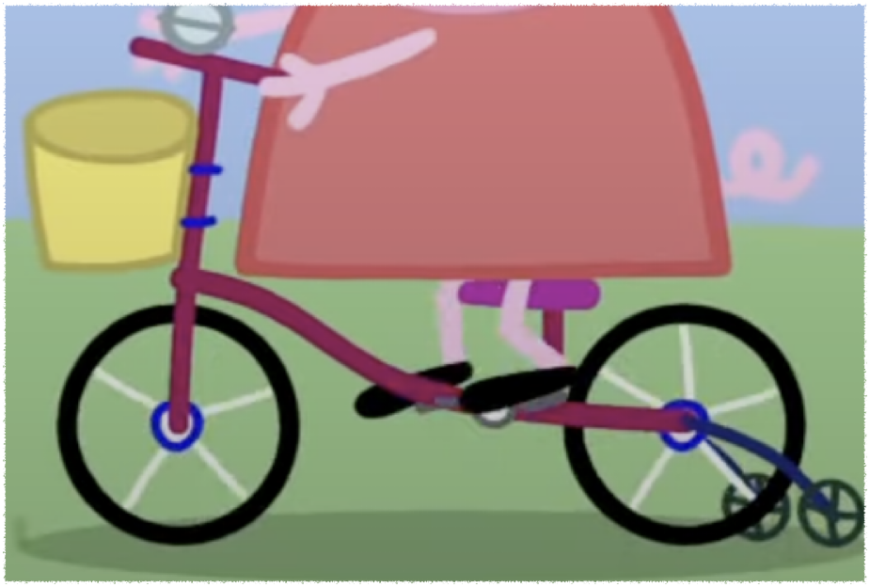
B b
Bicycle
Baby
Broken
Notes:
They are riding their bicycles

Slide 3
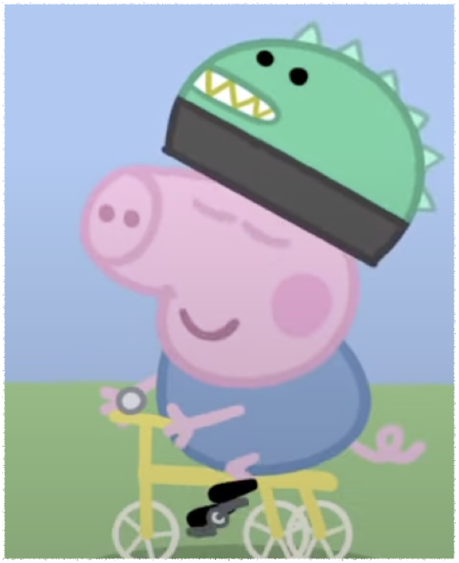
B b
Bicycle
Baby
Broken
Notes:
George is riding a baby bike

Slide 4
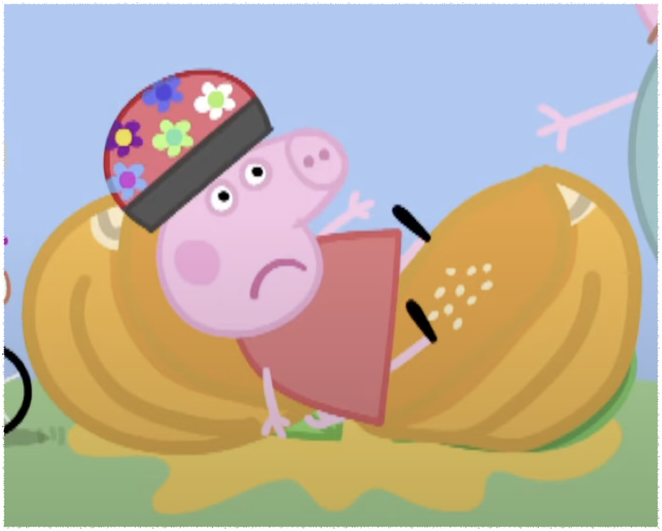
B b
Bicycle
Baby
Broken
Notes:
The pumpkin is broken

Slide 5
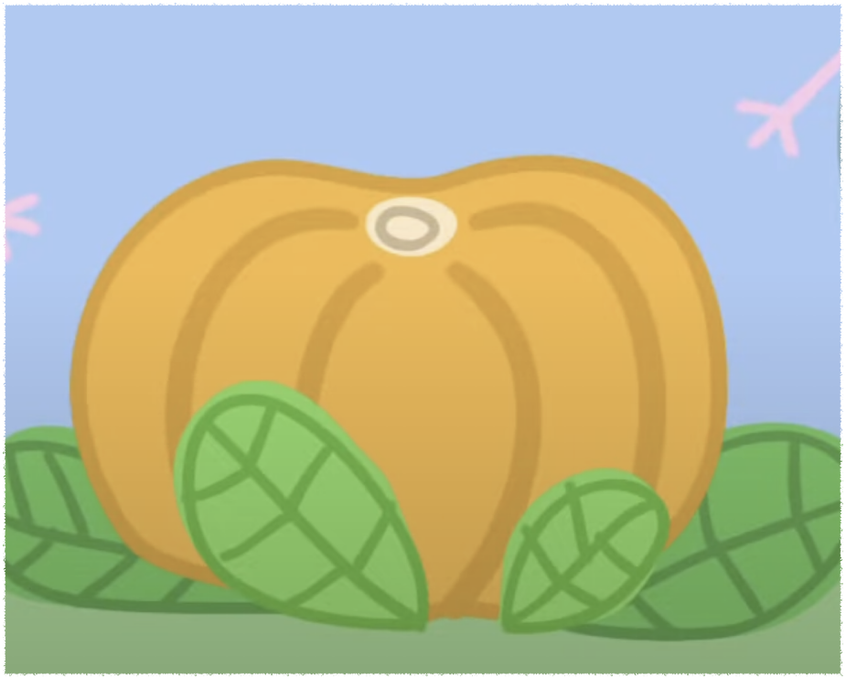
P p
Pumpkin
Notes:
There is a big pumpkin in the garden

Slide 6
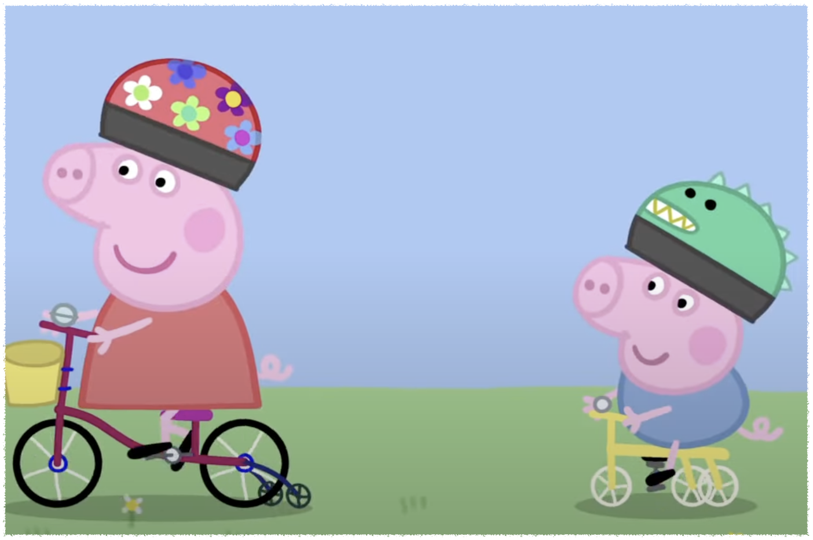
R r
Ride
Race
Notes:
They are riding their bicycles

Slide 7
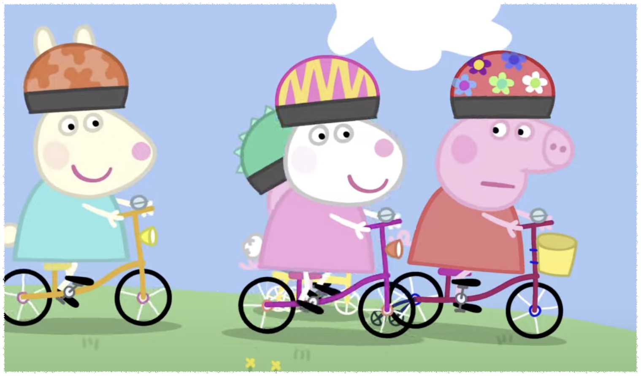
R r
Ride
Race
Notes:
Let’s race to the pumpkin

Slide 8
Are you coming?
Look at me
I can do it
You are doing really well

